Slide 1
Natural Language Processing with Disaster Tweets
Sai Kumar Reddy Nossam
Abhinay Reddy Guntipally
Vineeth Billa Kanti
Likitha Guthikonda

Slide 2
Agenda
What is BERT?
Transformer Based Model Advantages
What is Model Fine Tuning?
Different Fine-Tuning Techniques
Exploring the Dataset

Slide 3
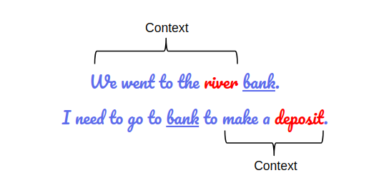
What is BERT?
Bidirectional Encoder Representations from Transformers:
Encoder Representations: It is a language representation model aiming to get an understanding of words/sentences by mathematically encoding them.
From Transformers: A very potent NLP algorithm called Transformer was created to handle a variety of sequence-to-sequence jobs.
Bidirectional: BERT uses both the information from left and right in the text to capture the meaning of a given word

Slide 4
Transformer Based Model Advantages
First Benefit:
These models do not process an input sequence token by token rather they take the entire sequence as input in one go which is a big improvement over RNN based models because now the model can be accelerated by the GPUs.
Second Benefit:
We don’t need labeled data to pre-train these models. It means that we have to just provide a huge amount of unlabeled text data to train a transformer-based model.
We can use this trained model for other NLP tasks like text classification, named entity recognition, text generation, etc. This is how transfer learning works in NLP.

Slide 5
What is Model Fine-Tuning?
BERT is a big neural network architecture, with a huge number of parameters, that can range from 100 million to over 300 million. So, training a BERT model from scratch on a small dataset would result in overfitting.
So, it is better to use a pre-trained BERT model that was trained on a huge dataset, as a starting point. We can then further train the model on our relatively smaller dataset and this process is known as model fine-tuning.

Slide 6
Different Fine-Tuning Techniques:
Train the entire architecture:
We can further train the entire pre-trained model on our dataset and feed the output to a softmax layer.
In this case, the error is back-propagated through the entire architecture and the pre-trained weights of the model are updated based on the new dataset.
Train some layers while freezing others :
Another way to use a pre-trained model is to train it partially. What we can do is keep the weights of initial layers of the model frozen while we retrain only the higher layers. We can try and test as to how many layers to be frozen and how many to be trained.
Freeze the entire architecture :
We can even freeze all the layers of the model and attach a few neural network layers of our own and train this new model. Note that the weights of only the attached layers will be updated during model training.

Slide 7
Exploring the given Dataset
What are we predicting?
We are predicting whether a given tweet is about a real disaster or not. If so, predict a 1. If not, predict a 0.
Each sample in the train and test set has the following information:
The text of a tweet.
A keyword from the tweet. (although this maybe blank!)
The location the tweet was sent from (may also be blank)

Slide 8
Columns
Id – A unique identifier for each tweet.
Text – the text of the tweet.
Location – The location the tweet was sent from (may be blank)
Keyword – a particular keyword from the tweet (may be blank)
Target – in train.csv only, this denotes whether a tweet is about a real disaster (1) or not (0).

Slide 9


